Slide 1
CUDA Advanced Libraries
Quick Introduction to Linear Algebra

Slide 2
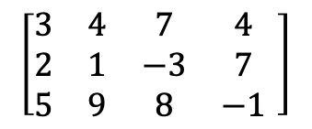
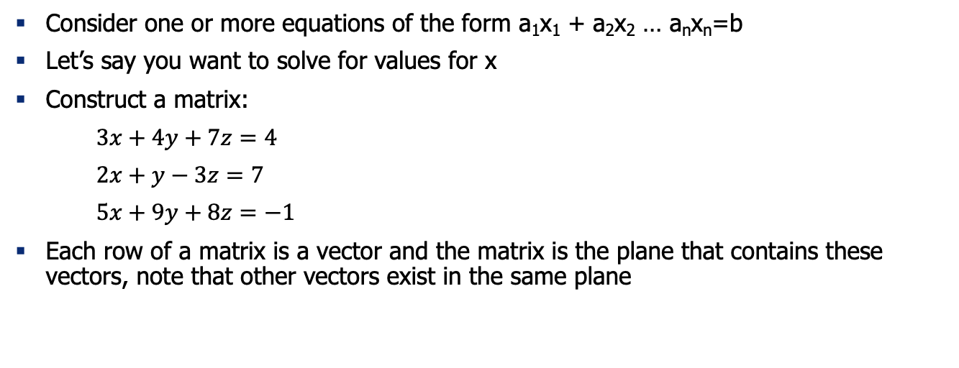
Basics
Consider one or more equations of the form a₁x₁ + a₂x₂ … a_{n}x_{n}=b
Let’s say you want to solve for values for x
Construct a matrix:
$3x+4y+7z=4$
$2x+y−3z=7$
$5x+9y+8z=−1$
Each row of a matrix is a vector and the matrix is the plane that contains these vectors, note that other vectors exist in the same plane
$$\left[\begin{matrix}3 & 4 & 7 & 4 \\ 2 & 1 & −3 & 7 \\ 5 & 9 & 8 & −1\end{matrix} \right]$$

Slide 3
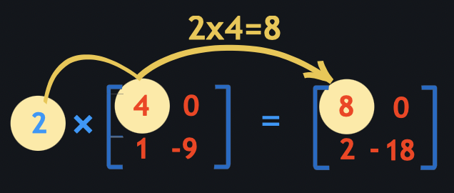
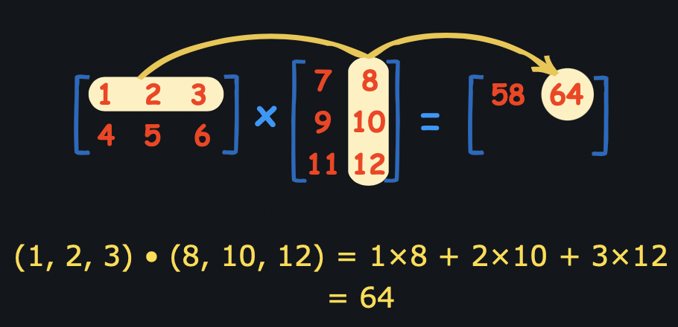
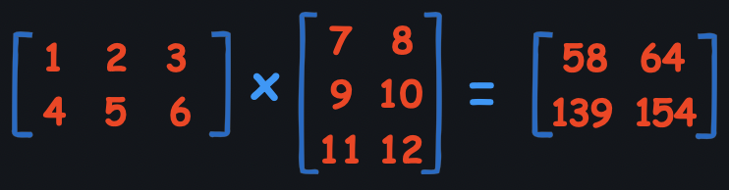
Matrix Operations
Scalar Multiplication
Dot product multiplication
[1]

Slide 4
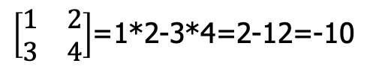
Matrix Determinant
This can only be calculated for square matrices
Matrix Determinant Calculation
This calculation gets more complex the higher the dimensions, so maybe we want to find something to do this calculation.
The determinant can be used to determine the size of a triangle (3x3 matrix with 1’s for the 3rd column), if the determinant is 0 the three points are collinear and so much more fun stuff.
$\left[\begin{matrix}1 & 2 \\ 3 & 4\end{matrix}\right]$=1*2-3*4=2-12=-10
[1]

Slide 5
References
[1] 2021. mathisfun.com. How to Multiply Matrices. Found at https://www.mathsisfun.com/algebra/matrix-multiplying.html.

